Slide 1


Keep Watch and Pray
Prayers during CoVid 19 crisis

Slide 2
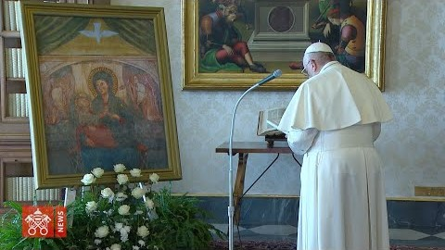
#Pray
Pope Francis composes a prayer to Our Lady, Health of the Sick, to implore her protection during the Covid-19 coronavirus pandemic.

Slide 3
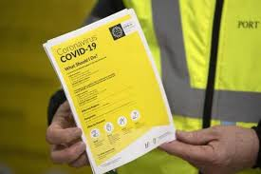
Prayer for Healthcare Workers during this time of the Coronavirus COVID-19
Loving God,
we place into your care
all our doctors, nurses and healthcare workers.
Give them courage of heart
and strength of mind and body.
Keep them safe from harm.
May they know our deep gratitude
for all they are doing
to heal and help those affected by
the coronavirus.
God of all consolation
may they know your protection and peace.
Bless them in these challenging days
and bless their families.
Amen

Slide 4
Prayer to the Holy Spirit
Come Holy Spirit, fill the hearts of your faithful and kindle in them the fire of your love. Send forth your Spirit and they shall be created. And You shall renew the face of the earth.
O, God, who by the light of the Holy Spirit, did instruct the hearts of the faithful, grant that by the same Holy Spirit we may be truly wise and ever enjoy His consolations, Through Christ Our Lord, Amen.

Slide 5
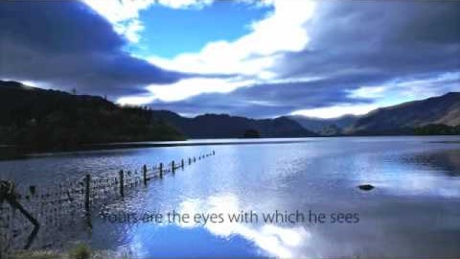
Christ Has No Body-
St Teresa of Avila
Christ Has No Body
Christ has no body but yours, No hands, no feet on earth but yours, Yours are the eyes with which he looks, Compassion on this world. Yours are the feet with which he walks to do good.
Yours are the hands with which he blesses all the world.
Ours are the hands, yours are the feet, Yours are the eyes, you are his body.
Christ has no body now but yours, No hands, no feet on earth but yours, Yours are the eyes with which he looks, Compassion on this world, Christ has no body now on earth but yours. (St Teresa of Avila)

Slide 6

St Patrick’s Breastplate
Christ be with me,
Christ be beside me,
Christ be before me,
Christ be behind me,
Christ be at my right hand,
Christ be at my left hand,
Christ be with me everywhere I go,
Christ be my friend for ever and ever.
Amen.

Slide 7
Prayers for Children
A prayer remembering God is with us
Lord God, you are always with me.
You are with me in the day and in the night.
You are with me when I’m happy and when I’m sad.
You are with me when I’m healthy and when I am ill.
You are with me when I am peaceful and when I am worried.
Today I am feeling (name how you are feeling) because (reasons you are feeling this way).
Help me to remember that you love me and are with me in everything today.
Amen.
A prayer for the world
God of love and hope,
you made the world and care for all creation,
but the world feels strange right now.
The news is full of stories about Coronavirus.
Some people are worried that they might get ill.
Others are anxious for their family and friends.
Be with them and help them to find peace.
We pray for the doctors and nurses and scientists,
and all who are working to discover the right medicines to help those who are ill.
Thank you that even in these anxious times,
you are with us. Help us to put our trust in you and keep us safe.
Amen.

Slide 8

Palm Sunday Mass on April 5th at 11am on RTE one TV
Solemn Liturgy for Good Friday 19 April – RTÉ One TV and from 3.00 p.m. to 4.15 p.m.
Easter Vigil Mass on Saturday 20 April – RTÉ One TV from 11.00 p.m. to 12.40 a.m.
Separately, the Irish Catholic Communications Office has released details of Vatican Television’s worldwide telecasts of the public liturgies to be celebrated by Pope Francis for Holy Week and Easter 2019.
19 April 2019: Good Friday Way of the Cross at the Colosseum, Celebration Time: 19.15–21.00
21 April 2019: Mass of Easter Sunday Saint Peter’s Square followed by the Holy Father’s Easter Message and Blessing (‘Urbi et Orbi’) at 12 noon
For further details of satellite broadcasts and updates see: www.worldtelecast/Easter2019.

