Slide 1
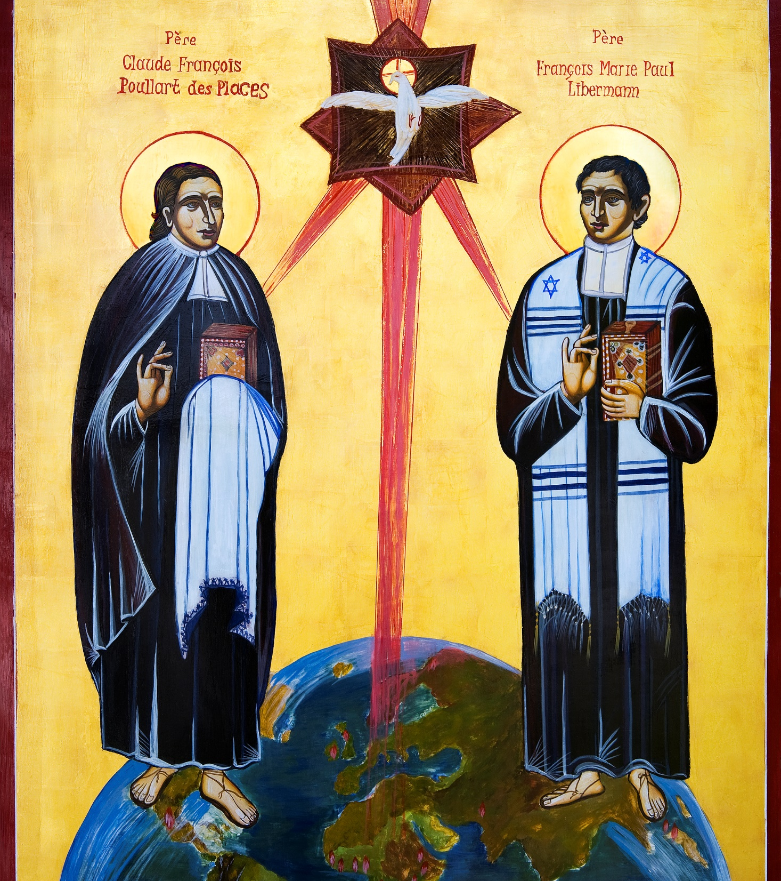


Slide 2



Slide 3

Claude Poullart Des Places
and Francis Libermann,
Spiritan Founders

Slide 4
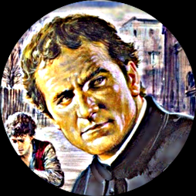
Remembering the life of Claude Poullart Des Places

Slide 5
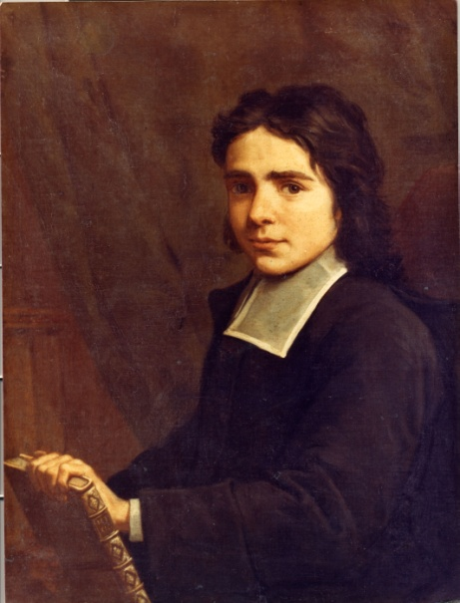
Claude François Poullart des Places
As one of the youngest founders of a major religious congregation (he founded the Spiritans at age 24), he accomplished so much and influenced so many other young people during his short life, that he continues to be a role model for young people today. Like them, he, too, had to struggle with all the agonies and ecstasies of growing up and making career decisions that at first were not fully understood or approved by his friends, his professors or even his family.
Claude began high school at the local Jesuit College in Rennes (St-Thomas). There, before long, he was recognized as an honour student. As valedictorian at his graduation he gave such a remarkable speech in Latin that he was invited to Versailles in Paris as guest of the Royal Family. Wow!
But Claude was more than a serious scholar. He was a great all-rounder, very popular with the staff and greatly admired by his peers.

Slide 6
Claude François Poullart des Places
A real time of change for Claude came when he was 19. To satisfy his parents’ wishes he spent three years in the Law School of Nantes. Claude once again passed all his exams with flying colours. At 22 he graduated with a Licentiate in Law. His family had great plans for him. Claude, however, had other ideas. He would become a priest.
With the world at his feet and so many promising careers open to him, he had great difficulty deciding between a military career (a family tradition), law and politics (like his father), management and future ownership of the family real-estate business (as only son), or the priesthood where he saw several possibilities as a diocesan or a religious priest. But once the die was cast, there was no turning back; not even a compromise with his family’s suggestion that he now combine his theological studies with another degree at the Sorbonne, the University of Paris.
No, Claude would concentrate solely on the spiritual preparation and take non-degree courses at the Jesuit College in Paris. This, as history was to show, made all the difference in his life.

Slide 7

Hope for the Poor
During his school and college Claude had been very active in the usual charitable organizations (many similar to the present day Vincent de Paul Society).
As a seminarian (students for the priesthood) at St. Thomas College and a member of the AA’s (The Assembly of Friends), he became involved in educating and helping immigrant chimney sweepers as well some poor seminarians at the Jesuit College.
Claude opened a hostel for the latter eventually became the famous Holy Spirit Seminary, and the nursery of a whole new religious foundation – the Congregation of the Holy Spirit (the Spiritans)

Slide 8
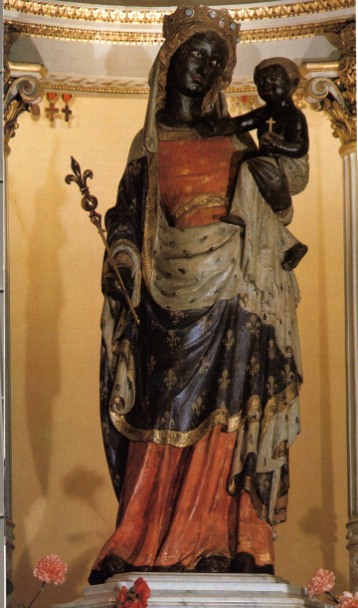
Mary blesses the generosity of the young.
On Pentecost Sunday, 1703, as Claude and his young companions gathered around the statue of Notre Dame de la Bonne Délivrance in the Church of St. Etienne des Grès, Paris , the Spiritan story began.

Slide 9
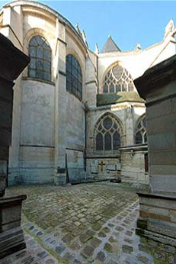
Remembered over
300 years later.
Most unexpectedly in the late summer of 1709 he fell seriously ill of pleurisy. He died peacefully at the age of 30 years and 7 months on October 2 of that year.
Claude made only one request in his last days, that his friends bury him not with an expensive tombstone, but in a nameless plot among the poorest of the poor, whom he and they had pledged to serve.

Slide 10
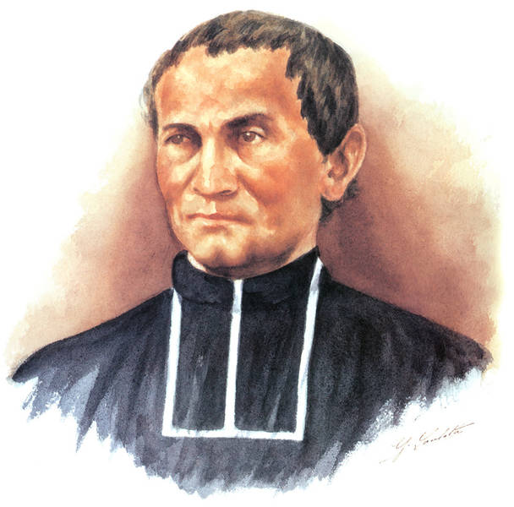
Remembering Venerable Francis Libermann

Slide 11
Spiritan Education
What is a Spiritan?
Where do we find Spiritans?
Do you know any Spiritans?

Slide 12
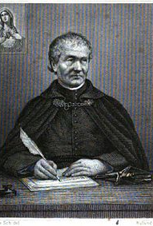
Timeline
1802 Born into a Jewish family at Saverne, Alsace, France. The son of a Jewish Rabbi.
1826 Baptised a Catholic in Paris.
1841 Ordained priest and founded the Society of the Holy Heart of Mary.
1843 Sent out his first missionaries to Guinea.
1847 His society merged with the Holy Spirit Congregation (The Spiritans).
1852 Died at Rue Lhomond in Paris on February 2nd.
1910 Declared Venerable by Pope Saint Pius X.

Slide 13
An Extraordinary
Faith Journey
Venerable Francis Libermann had a most remarkable journey of faith. He was born into an orthodox Jewish family in the Alsace region of France in 1802, and given the name Jacob.
Jacob Libermann’s father was a rabbi, and Jacob was preparing to become a rabbi himself when his studies led him to the New Testament and to Christianity.
He was baptized as a Catholic Francis Mary Paul, in 1826, at Christmas.
Soon he was studying for the Catholic priesthood, but suffered illness (epilepsy) which delayed his ordination.
He was finally ordained, in 1841.

Slide 14
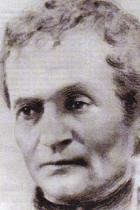
A Second Founder.
In 1848 Libermann brought personnel and a renewed Spiritual energy to the Spiritans that transformed the Congregation.
Those intervening years were a time of grace and of maturing, as Libermann became an advisor and confidant to many seminarians and others wanting to grow in the spiritual life.
His insightful approach of “practical union with God” helped him, and others, find the story of God in the everyday life.
His unique spirituality of remining responsiveness to the Holy Spirit served Libermann well during the difficult period of organizing his Congregation of gaining official permission from Rome to begin this apostolate to people of African descent.

Slide 15
Another Missionary pioneer.
Libermann recruited and educated missionaries, both lay and clerical. He negotiated with Rome and with the French government over the placement and support of his personnel.
Francis Libermann was a pioneer of strategies now recognized as a blueprint for modern missionary activity. He urged the Spiritans to “become one with the people” so that each group received and understood the Gospel in the context of their own traditions. Fr. Libermann’s zeal was so inspiring that despite the death of the first missionaries to West Africa, they still volunteered as replacements.

Slide 16

Not afraid of adventure.
The main commitment of these missionaries was the poorest and those most in need. They committed to serve the people in the world around them, no matter where they were.

Slide 17
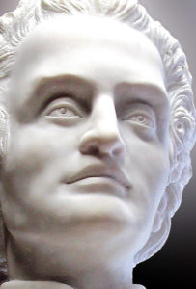
February 2nd 1852
He exhausted himself in the process of leading his great enterprise, and died on February 2, 1852 before his 50th birthday. Surprisingly, Fr. Libermann himself never went overseas. Yet he inspired and empowered literally thousands of missionaries around the globe.
Libermann was a visionary, a missionary, a profoundly spiritual man who has affected the course of history in the last 150 years. His influence and that of his Spiritans, in the Church and in the emerging world (including our own country since the late 19th century) has been inestimable.
.

Slide 18
Signs and Shapes of Growth.
By the end of the 19th century, there were Spiritan provinces across Europe, including, Ireland. The Spiritans established schools for the development of Faith and Mission.
The Irish Spiritan School family includes;
Blackrock College, Willow Park 1st year and Willow Park Junior School
St. Mary’s College, Senior and Junior Schools
St. Michael’s College, Senior and Junior Schools
Templeogue College
Rockwell College
Holy Faith Community School.

Slide 19
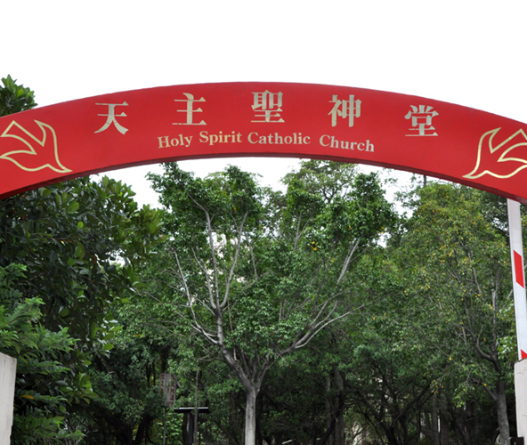
The wind blows where it chooses (John 3,8)
Irish Spiritan missionaries have gone in many different directions for one reason: to serve people in need.
Papua New Guinea, to Australia, Taiwan, Philippines, Vietnam, to Paraguay and to Bolivia, West to East Africa.

Slide 20
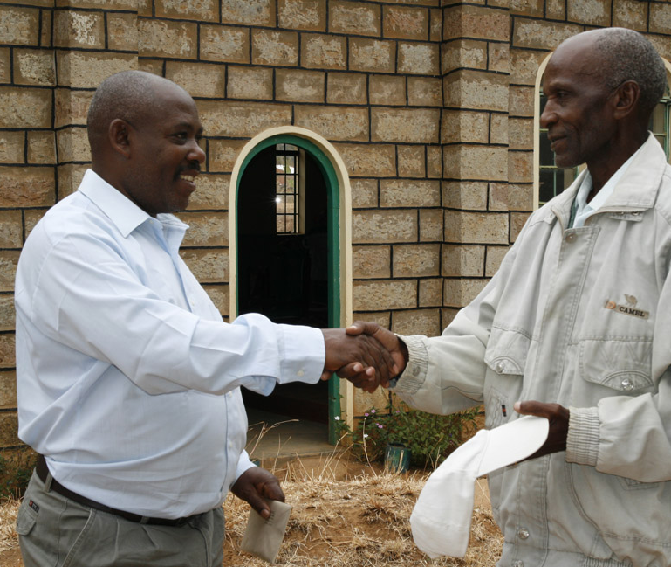
People and places.
The 20th century was marked by spectacular growth of the Church, around the world, especially in Africa .

Slide 21
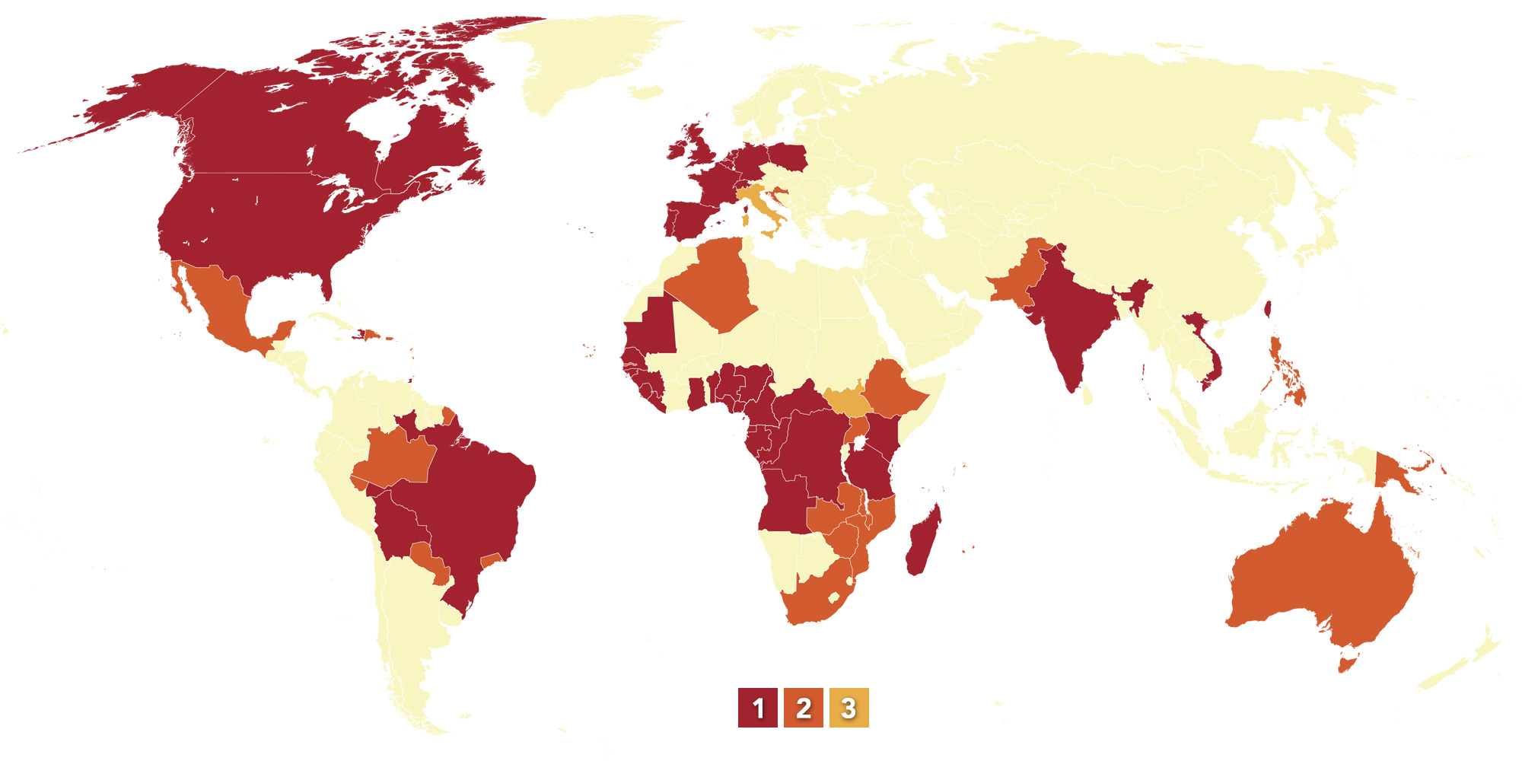
Go Teach all Nations (Mt; 28,19)
Photo: Pentecôte sur le monde
There are over 3,000 members in the Congregation serving in 32 different countries worldwide

Slide 22
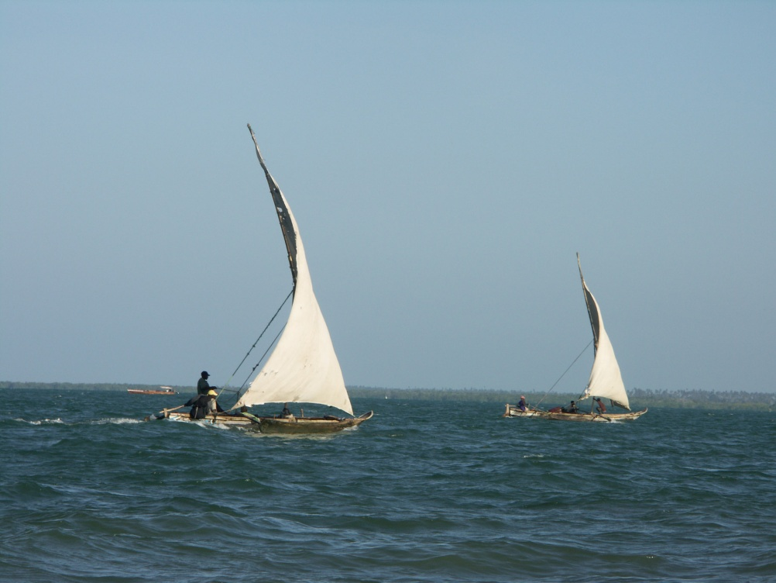
Wind in our sails…
The most important Spiritan meeting, its General Chapter, is a major moment of assessment and renewal. It takes place every 6 years.
During this time Spiritans reflect on (think about deeply) their mission.
The next chapter will take place in June/July 2020.

Slide 23
Activities – Show what you know!
Write a Poem… About Francis Libermann’s/Claude Poullart Des Places’ life, work or journey etc.
Interview… Imagine you are a reporter interviewing Francis Libermann or Claude Poullart Des Places. What are the questions you want to ask him and how do you think he would respond?
Design a Poster… For Francis Libermann/Claude Poullart Des Places Day. Include Spiritan symbols, logos, words, phrases and names.
Write a story… You are a missionary being sent off to a far away land. Before you go, you must gather the best people you know. Who are you going to choose and why?
Cartoon… You are a missionary being sent off to a far away land where the people have no idea about our ways. What is it like, how do you do your work?

Slide 24
The Heart, Mind and Soul Reflection
Francis Libermann (Spiritan Co-Founder) 1802-1852
A ship has sails and rudder;
The wind blows into the sail,
Getting the ship to proceed as it should,
So it advances by its sails
And takes its general direction.
Yet this direction could be too vague And could lead the ship astray at times. So there is the rudder, To guide it exactly in its due course
Without straying in any way.
Your soul is the ship,
Your heart represents the sail,
The Holy Spirit is the wind;
He blows into your will and your soul goes forward,
Proceeding towards the goal God proposes for it.
Your mind is the rudder to prevent you, in the strength and movement given to your heart, From departing from the straight line
Determined by the divine goodness

Slide 25


Thank you Claude Poullart Des Places and Francis Libermann!

