Slide 1
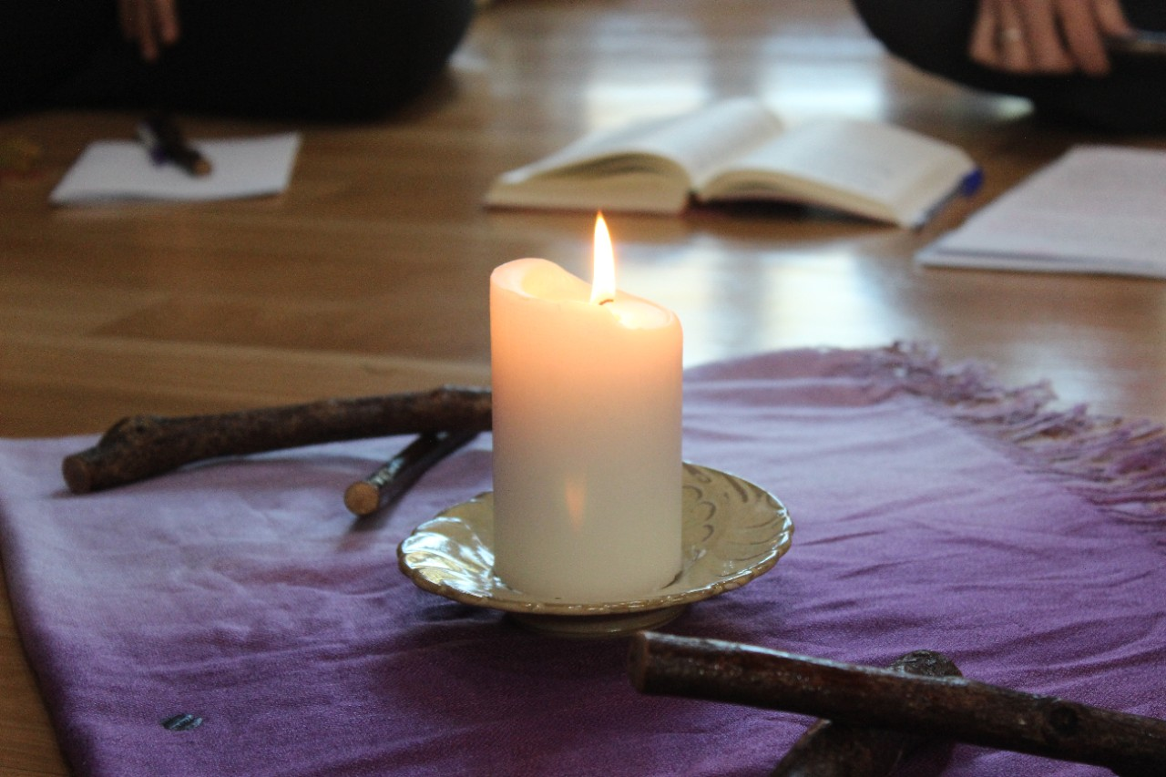
“Come back to me with all your heart” Joel 2:12
Lenten Prayer Assemblies

Slide 2
Introduction to Lent
Lent is a time of repentance and renewal. From the time of the early church it was also a period of preparation for baptism. Baptisms took place at the Easter Vigil and it was a time of celebration for the whole Christian community. Those who were getting ready for baptism entered a time of preparation some called The Catechumenate. This was a time of immersion into the teachings of Jesus Christ and the challenge of Christian living. Catechumens prepared for months sometimes years. Their preparation intensified during Lent, when they learned the Apostles Creed,
The Lord's Prayer and were immersed in the Gospel message. The kind of preparation for adults has been restores in some parishes. Lent is a time of prayer, fasting and alms giving the prepared us all to commemorate the passions, death, and resurrection of Our Lord Jesus Christ. We are challenged to take a close look at our lives and respond to God’s invitation to – “Come back to me with all your heart”. Prayers, fasting and alms giving can intensify our preparation and focus us on what is really important in our lives.
This prayer card is designed as a guide for this time of preparation. It is particularly suited for family prayer and small groups. It can equally be used for private prayer. The format can be supplemented with Lenten chants/songs and punctuated with silent reflection and personal sharing. The Psalm response for each week can be used repeatedly in personal prayer.

Slide 3
Lenten Prayer
In the name of the Father, the Son and Holy Spirit …
Opening Prayer
Psalm
Gospel Reading
Reflection/Sharing
Intercessions
Our Father
Concluding Prayer

Slide 4
1st Sunday of Lent (13th March)
Opening Prayer: Let my prayer rise before you like incense.
Psalm: Response: Have mercy on us, O Lord, for we have sinned. (Psalm 50)
Have mercy on me, God, in your kindness. In your compassion blot out my offences. O wash me more and more from my guilt and cleanse me from my sin.
Have mercy on us, O Lord, for we have sinned.
Sunday Gospel Matthew 4;1-11
“Next, taking him to a very high mountain, the devil showed him all the kingdoms of the world and their splendour. “I will give you all these”, he said, “if you fall at my feet and worship me”. Then Jesus replied “Be off Satan! For scripture says, You must worship the Lord your God, and serve him alone.
Reflection
This Gospel challenged the original hearers of this episode from the life of Jesus. The gospel is a challenge for us also. How did Jesus cope with the temptations? What are the temptations we face in our everyday life?
Prayer Almighty God, your Son Jesus Christ, fasted forty days in the wilderness, and was tempted as we are today. Help us to hear your voice in the desert places of our lives. Increase our faith and hope in you. May your living word nourish us and give us strength. You know our weakness. May we know your power to save us through Jesus Christ our Lord. Amen.

Slide 5
2nd Sunday of Lent (20th March)
Opening Prayer: Let my prayer rise before you like incense.
Psalm: Response: May your love be upon us O Lord, as we place all our in hope in you. (Psalm 32)
The word of the Lord is faithful
And all his works to be trusted.
The Lord loves justice and right
And fills the earth with his love.
May your love be upon us O Lord, as we Place all our hope in you
Sunday Gospel Matthew 17:1-9
“He was still speaking when suddenly a bright cloud covered them with shadow, and from the cloud there came a voice which said, “This is my Son, the Beloved; he enjoys my favour. Listen to Him. “When they heard this, the disciples fell on their faces, overcome with fear. But Jesus came up and touched them. "Stand up" he said "do not be afraid". And when they raised their eyes they saw no one but only Jesus.
Reflection
How do you think the disciples felt during and after this experience? Some disciples went up a mountain away from the crowds. Do we take the opportunity to spend time alone with God? How easy do we find it to listen to God? Have you ever had an extraordinary experience that enriched your faith?
Prayer God our Father, help us to hear your Son. Enlighten us with your word so that we may follow you and live. You have created us for yourself, you have called us into being: all that we are, all that we do, we give to you in love. Amen.

Slide 6
3rd Sunday of Lent (27th March)
Opening Prayer: Let my prayer rise before you like incense.
Psalm: Response: Oh that today you listen to his voice. “Harden not your hearts”. (Psalm 94)
Come, ring out our joy to the Lord;
Hail the rock who saves us.
Let us come before him, giving thanks,
With songs let us hail the Lord."
Oh that today you listen to his voice: "Harden not your hearts".
Sunday Gospel John 4:5-42
“Whoever drinks this water will get thirsty again; but anyone who drinks the water that I shall give will never be thirsty again; the water that I shall give will turn into a spring inside him, welling up to eternal life.
“Sir” said the woman, “give me some of that water, so that I may never get thirsty and never have to come here to draw water”.
Reflection
Although culturally unacceptable, Jesus engaged in a conversation with the Samaritan woman. Jesus’ words touched her heart. She responded to the offer of everlasting water immediately and she could not keep this good news to herself. She ran to tell others to come and meet Jesus. Why do you think Jesus revealed himself as the Messiah to her?
Jesus is making the same offer to each one of us. How do we want to respond? In what ways can we tell others bout Jesus?
Prayer
Father, when Jesus asked the woman of Samaria for water to drink she was already prepared to give. When she was offered the water of life, she responded in faith and trust. May I respond to the gift of living water so that I may never thirst and be open to the presence of Christ in others. Amen

Slide 7
4th Sunday of Lent (3rd April)
Opening Prayer: Let my prayer rise before you like incense.
Psalm: Response: The Lord is my shepherd; there is nothing I shall want. (Psalm 22)
The Lord is my shepherd; there is nothing I shall want.
Fresh and green are the pastures
where he gives me repose.
Near restful waters he leads me, to revive my drooping spirit.
The Lord is my shepherd; there is nothing I shall want.
Sunday Gospel John 9:1-41
Jesus heard they had driven him away, and when he found him he said to him, ‘Do you believe in the Son of Man?’ ‘Sir,’ the man replied ‘tell me who he is so that I may believe in him.’ Jesus said, ‘You are looking at him; he is speaking to you.’ The man said, ‘Lord, I believe’, and worshipped him.
Reflection
The Pharisees strictly observed the law which did not permit any work on the Sabbath. Jesus healed on the Sabbath. This was good news which gave glory and praise to God. How was the man born blind treated by Jesus? How was he treated by the Pharisees? Are there times when we judge others according to their appearance, social position etc. The Pharisees believed that they were doing God's will. At times spiritual blindness prevented them from showing compassion to others. Have I lost the treasure of compassion? How open is my heart to the cares of others?
Prayer
Father, you enlighten all who come into the world. Fill our hearts with the light of your Gospel, that our thoughts may please you and our love be sincere. May our hearts be filled with compassion for those in need. Amen.

Slide 8
5th Sunday of Lent (10th April)
Opening Prayer: Let my prayer rise before you like incense.
Psalm: Response: With the Lord there is mercy and fullness of redemption. (Psalm 129)
Out of the depths. I cry to you, O Lord,
Lord, here my voice! O let your ears be attentive to the voice of my pleading
O let your ears be attentive to the voice of my pleading.
Sunday Gospel John 11:1-45
The Jesus lifted up his eyes and said: “Father, I thank you for hearing my prayer. I knew indeed that you always hear me. But I speak for the sake of all those who stand round me, so that they may believe it was you who sent me. When he had said this, he cried in a loud voice. “Lazarus, here! Come out!” The dead man came out, his hands and feet bound with strips of cloth and his face wrapped in a cloth. Jesus said to them, “Unbind him, let him go free”.
Reflection
Martha, Mary and Lazarus were friends of Jesus yet Jesus arrived too late to heal Lazarus. When Jesus arrives Lazarus has already been buried for four days. Martha and Mary are grief stricken. Jesus weeps with them at the loss of Lazarus. Jesus calls Lazarus from death. It is a powerful image for us. What is God calling us from in our own lives? What prevents us from living the Christian life?
Prayer
Lord Jesus in raising Lazarus from the dead, you demonstrated that we can have life to the full. You have rolled away the stones which have imprisoned us. May we embrace this new life and radiate your love to others. You are the way, the truth and the life. Amen.

